Slide 1
Reweight Validation Step-By
Marinette, WI
September 29th, 2016
Matthew Streckenbach

Slide 2

Introduction
Why do we do reweights?!
Part of the General process of submittal (FMM Sends to LM, LM approves, FMM Submits via contracts, LM pays FMM)
Quarterly update of Billing price
Projects final price of contract
Tracks historical performance
Submittals of two files, ACWP/EAC Pivot (For Validation purposes) & LCS # Reweight… (Containing actuals & EAC’s)

Slide 3
ACWP/EAC Pivot (From FMM)
Access EAC-ACWP Reweight file & merge Pivot Table with current quarter reweight file
Use prior months (reweights are always one month behind) CPR 1 Dollars/Hours, CPR 2 Hours, W/e BAAN report to validate data.
October use August January Use November April use February July use May

Slide 4
Reweight table
Validate Labor Dollars, on Input tab (using pivot, Actuals, & CPR)
COM, Direct, GACOM, GANDA, OH
Validate Material Dollars (using pivot, Actuals, CPR 1 Dollars)
Validate Labor Hours (using pivot, actuals, CPR, BAAN)
Manufacturing Hours (Using CPR 2 Hours Validation backup)
Non-Manufacturing Labor Hours (Using CPR 2 Hours)
Verify ODC ties (Using Pivot, Actuals)
Verify grand total $$ & Hours = Month End ACWP (Using CPR 1 Dollars/Hours)

Slide 5
Mod & Invoice Log
Verify correct Target cost, Incentive Fee, Target Price, Ceiling (Using CPR F1 $ used as validation/backup, & Section B of Mod Log)

Slide 6
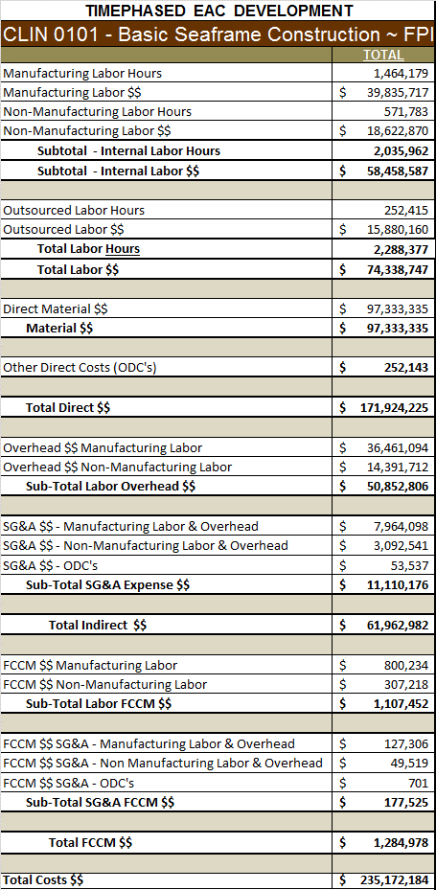
EAC’s Time phased
Repeat Steps from Actuals with EAC Time-phased…

Slide 7
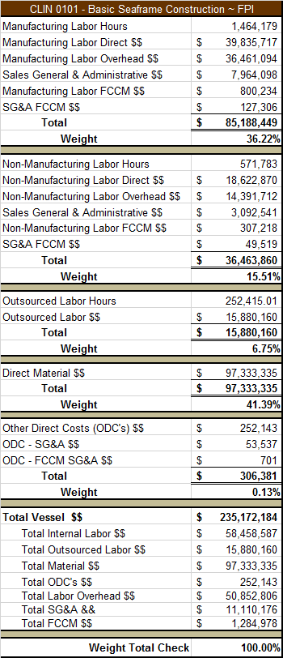
Weights
Verify weighting factors tie using EAC Development Tab
Make Sure weighting factor =100%

Slide 8
Progress
**
Verify Manufacturing Labor Discrete process using BAAN Report BCWP/BAC
Verify Non-Manufacturing Labor & Material Tie using Weights on previous tab
This will equal total ship progress**
Outsource labor manually placed in by FMM– 7-15 Through outsourced file, 15+Baan as well. Verify from Outsource file using Current BCWP/BAC—Highlight in Yellow

Slide 9
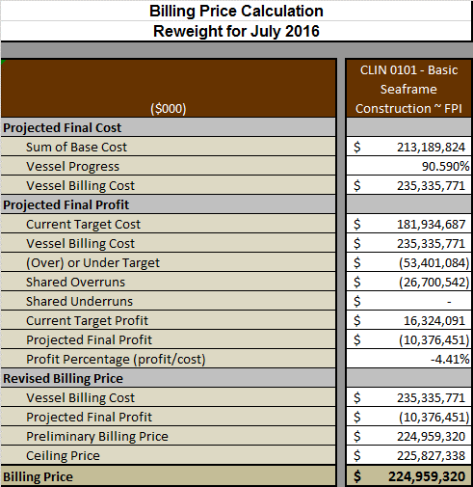
Billing Price
Sum of Base Cost =Actuals
Verify Ship Progress is equal using progress tab
Verify Ship Billing Cost via Progress Tab (BCWP/BAC) Use ETC to assume whether this is accurate. Positive Negative?
Confirm Current Target Cost vs Vessel Billing Cost(Using Formula)
Verify whether Ship is over/under target cost
This will lead to shared overruns or underruns. Never both. Please verify the formula
This will then show final projected profit/loss & %
Billing price may not equal Vessel Billing Cost once ship has hit ceiling.

Slide 10
Verify Premise & Proposal Tab
Confirm the costs are in the correct period using Prior month CPR’s/BAAN Data
Review Proposed Revisions (Vessel Billing Price equals prior table, & Weighting factors from prior tab.)

